Slide 1
Guava
May. 14th , 2018

Slide 2
What is Guava
Basic utilities.
Strings
Collections.

Slide 3
What is Guava?
The Guava project contains several of Google's core libraries that we rely on in our Java-based projects: collections, caching, primitives support, concurrency libraries, common annotations, string processing, I/O, and so forth. Each of these tools really do get used every day by Googlers in production services.

Slide 4
Import guava
Maven:
<dependency>
<groupId>com.google.guava</groupId>
<artifactId>guava</artifactId>
<version>21.0</version>
</dependency>

Slide 5
Basic utilities
Option
Careless use of null can cause a staggering variety of bugs. Studying the Google code base, we found that something like 95% of collections weren't supposed to have any null values in them, and having those fail fast rather than silently accept null would have been helpful to developers.
Additionally, null is unpleasantly ambiguous. It's rarely obvious what a null return value is supposed to mean -- for example, Map.get(key) can return null either because the value in the map is null, or the value is not in the map. Null can mean failure, can mean success, can mean almost anything. Using something other than null makes your meaning clear.

Slide 6
Basic utilities
Option
Each of these are static methods on Optional：
Optional.of(T) | Make an Optional containing the given non-null value, or fail fast on null.
Optional.absent() | Return an absent Optional of some type.
Optional.fromNullable(T) | Turn the given possibly-null reference into an Optional, treating non-null as present and null as absent.
Notes:
1. Of method T generic can not a reference that point to a null, or will get the null pointer exception. If we pass a list, must make sure there is null value in the list or also can get the null pointer exception.
2. An absent option instance can also call the of method to create a option instance that contains a not null value.
3. fromNullable method can pass into a null value.

Slide 7
Basic utilities
boolean isPresent() | Returns true if this Optional contains a non-null instance.
T get() | Returns the contained T instance, which must be present; otherwise, throws an IllegalStateException.
T or(T) | Returns the present value in this Optional, or if there is none, returns the specified default.
T orNull() | Returns the present value in this Optional, or if there is none, returns null. The inverse operation of fromNullable.
Set<T> asSet() | Returns an immutable singleton Set containing the instance in this Optional, if there is one, or otherwise an empty immutable set.
Option
Use Optional instance to
Search reference:
（the flowing method
Isn’t a static method）：
Notes:
Or method parameter can not allow a null value or will get exception.

Slide 8
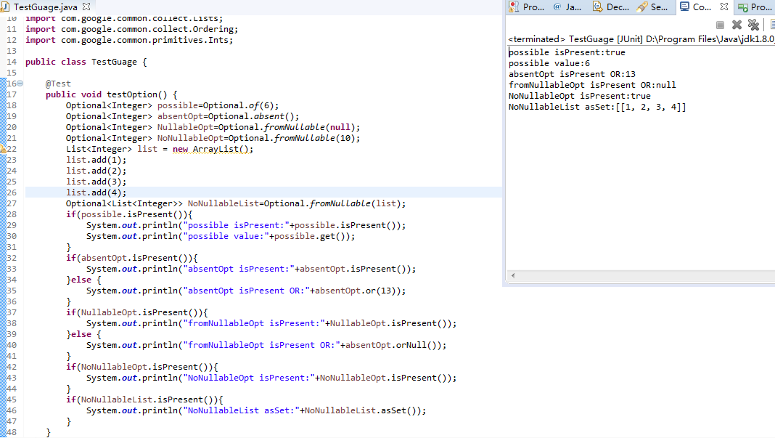
Basic utilities
Option

Slide 9
Basic utilities
Preconditions:
Guava provides a number of precondition checking utilities. We strongly recommend importing these statically.
Each method has three variants:
No extra arguments. Any exceptions are thrown without error messages.
checkArgument(boolean);
2. An extra Object argument. Any exception is thrown with the error message object.toString().
checkArgument(boolean expression, Object object)
3. An extra String argument, with an arbitrary number of additional Object arguments. This behaves something like printf, but it only allows %s indicators. Examples：
checkArgument(i >= 0, "Argument was %s but expected nonnegative", i);
checkArgument(i < j, "Expected i < j, but %s > %s", i, j);
Notes:
1. Perconditions just like junit Assert method，used to check the method parameters.

Slide 10
Basic utilities
Signature (not including extra args) | Description | Exception thrown on failure
checkArgument(boolean) | Checks that the boolean is true. Use for validating arguments to methods. | IllegalArgumentException
checkNotNull(T) | Checks that the value is not null. Returns the value directly, so you can use checkNotNull(value) inline. | NullPointerException
checkState(boolean) | Checks some state of the object, not dependent on the method arguments. | IllegalStateException
checkElementIndex(int index, int size) | Checks that index is a valid element index into a list, string, or array with the specified size. An element index may range from 0 inclusive to size exclusive. You don't pass the list, string, or array directly; you just pass its size. | IndexOutOfBoundsException
checkPositionIndex(int index, int size) | Checks that index is a valid position index into a list, string, or array with the specified size. A position index may range from 0 inclusive to size inclusive. You don't pass the list, string, or array directly; you just pass its size. Returns index. | IndexOutOfBoundsException
checkPositionIndexes(int start, int end, int size) | Checks that [start, end) is a valid sub range of a list, string, or array with the specified size. Comes with its own error message. | IndexOutOfBoundsException
Preconditions
Notes:
checkNotNull will return the current parameter if current parameter is not null。
Each method has tree variants method.

Slide 11
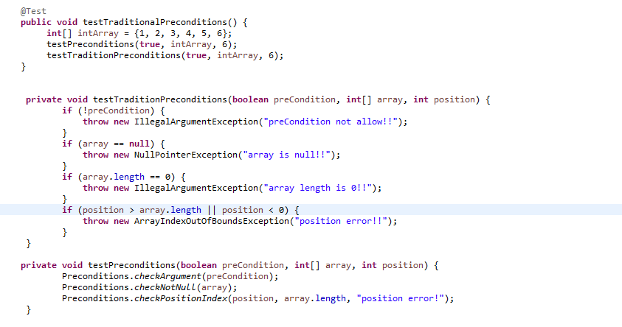
Basic utilities
Preconditions

Slide 12
Basic utilities
Object common methods
Object common methods including: equals, hashCode, toString, compare/compareTo and so on，Guava also provide similar methods and provide convenient for developers。
Notes:
We often override euqals and hashcode method to check if two instance is the same instance.
toString method often to be used to print the business object message.
compare/compareTo is used to compare two instance，it’s very usefull when we try to odering the collections that contains the target class instance.

Slide 13
Basic utilities
Objects
equals
When your object fields can be null, implementing Object.equals can be a pain, because you have to check separately for null. Using Objects.equal lets you perform equals checks in a null-sensitive way, without risking a NullPointerException.
1. Objects.equal("a", "a"); // returns true
2. Objects.equal(null, "a"); // returns false
3. Objects.equal("a", null); // returns false
4. Objects.equal(null, null); // returns true

Slide 14
Basic utilities
Objects
hashCode
Hashing all the fields of an Object should be simpler. Guava's Objects.hashCode(Object...) creates a sensible, order-sensitive hash for the specified sequence of fields. Use Objects.hashCode(field1, field2, ..., fieldn) instead of building the hash by hand.
Note: The newly introduced Objects class in JDK 7 provides the equivalent:
Objects.hash(Object...)
Notes:
Hashcode method support the null parameter.
End： to override the equals method is so complicate and the efficiency is not that good, but compared with the hascode method, only to generate a hascode then compared with each other, obviously it’s more efficient, the question is why we still need equals method？

Slide 15
Basic utilities
Objects
hashCode() not completely reliable, sometimes different object can has the same hascode，so hashCode() reliable in the most case，but not always，so we can get the conclusion：
1.if got true value when calls the equal() method their hashCode() value must be the same，so the equals() method always reliable。
2. if two objects has the same hashCode then call the equal() method may got false ，so the hashCode() method isn’t reliable。
hashCode
Notes:
Let’s give an example of HashMap，when we called the put() method，the hashmap will generate a hashcode according to the key； when we called the get， firstly the hasmap will compared the has code if the same, if not a null value will be returned, if so then will call the equals method to check if the key is definitely the same then return the corresponding value.

Slide 16
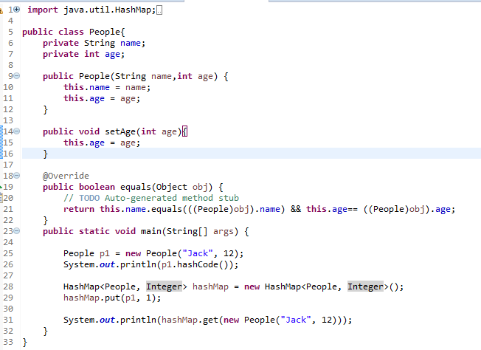
Basic utilities
Objects
hashCode

Slide 17
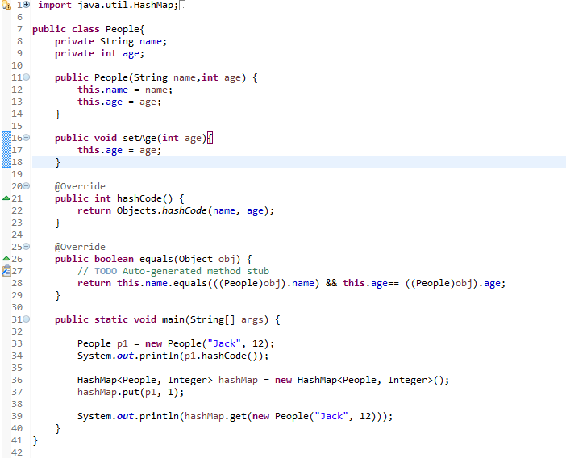
Basic utilities
Objects
hashCode

Slide 18

Basic utilities
MoreObjects
toString
good toString method can be invaluable in debugging, but is a pain to write. Use MoreObjects.toStringHelper() to easily create a useful toString. Some simple examples include:
// Returns "ClassName{x=1}"
MoreObjects.toStringHelper(this).add("x", 1).toString();
// Returns "MyObject{x=1}"
MoreObjects.toStringHelper("MyObject").add("x", 1).toString();
Notes:
1. Sometime we need to omit the null attribute values, so we can call omitNullValues method to omi the null values.

Slide 19
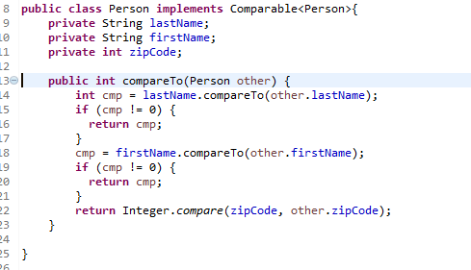
Basic utilities
ComparisonChain
Implementing a Comparator, or implementing the Comparable interface directly, can be a pain. Consider:

Slide 20
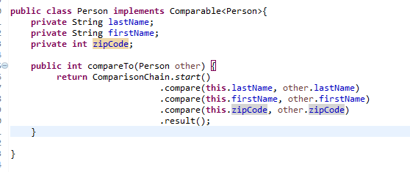
Basic utilities
ComparisonChain
This code is easily messed up, tricky to scan for bugs, and unpleasantly verbose. We should be able to do better.
For this purpose, Guava provides ComparisonChain.
ComparisonChain performs a "lazy" comparison: it only performs comparisons until it finds a nonzero result, after which it ignores further input.
Notes:
ComparisonChain is abstract method
ComparisonChain.start method provide a ComparisonChain instance and but it is not thread-safe。
ComparisonChain has three implement class，ACTIVE, LESS, GREATER, to call the compare method if result less than 0 then the LESS instance will be returned, if the result greater than 0 then the GREATER instance will be return, if result equals 0 then the ACTIVE instance will be returned, only ACTIVE instance execute the compared action. GREATER OR LESS method will always return itself, through this way to implement that only if a nonzero result return then to ignore the future input.

Slide 21
Basic utilities
Ordering
Ordering is Guava's "fluent" Comparator class, which can be used to build complex comparators and apply them to collections of objects.
At its core, an Ordering instance is nothing more than a special Comparator instance. Ordering simply takes the methods that rely on a Comparator (for example, Collections.max) and makes them available as instance methods. For additional power, Ordering class provides chaining methods to tweak and enhance existing comparators.

Slide 22
But the more common way to create a custom Ordering is to skip the Comparator entirely in favor of extending the Ordering abstract class directly:
Basic utilities
Ordering
Common orderings are provided by static methods:
方法 | 描述
natural() | Uses the natural ordering on Comparable types.
usingToString() | Compares objects by the lexicographical ordering of their string representations, as returned by toString().
from(Comparator) | Making a preexisting Comparator into an Ordering
But the more common way to create a custom Ordering is to skip the Comparator entirely in favor of extending the Ordering abstract class directly: Ordering<String> byLengthOrdering = new Ordering<String>() {
        public int compare(String left, String right) {
        return Ints.compare(left.length(), right.length());
        }
        }
Notes:
natural() comparator called the compareTo method, so the pre-condition to order by nature is that the generic must implement the Comparable interface and the compareTo method must flow the nature ordering.
usingToString() method firstly called the toString method and then call the compareTo method to do the ordering.
The difference of these two methods is that the natural() comparator call the generic’s compareTo method and the userToString comparator call String’s compareTo method.

Slide 23
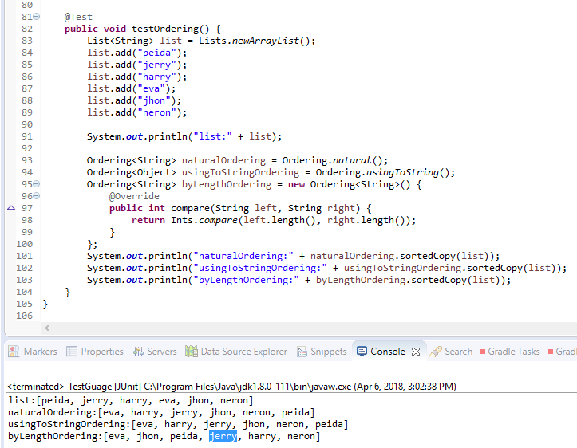
Basic utilities
Ordering
Notes:
Why Natural and useingToString comparator result is the same? Because both of them use the String’s compareTo method and current instance will be the same to call the toString method or not.
One thing should be note that the null value shouldn’t exist in the list, or will got exception during ordering.

Slide 24
Basic utilities
Ordering
A given Ordering can be wrapped to obtain derived orderings. Some of the most commonly used variations include:
Method | Description
reverse() | Returns the reverse ordering.
nullsFirst() | Returns an Ordering that orders nulls before non-null elements, and otherwise behaves the same as the original Ordering.
nullsLast() | Returns an Ordering that orders nulls after non-null elements, and otherwise behaves the same as the original Ordering.
compound(Comparator) | Returns an Ordering which uses the specified Comparator to "break ties."
onResultOf(Function) | Firtst call the parameter function then ordering by current function returned value。
Fluent interface: https://en.wikipedia.org/wiki/Fluent_interface
Notes:
Compound comparator will take effect when the current compared result is 0.
All of these methods can be called by fluent interface style.

Slide 25
Basic utilities
Ordering
Guava provides a number of methods to examine values or collections using the ordering. We list some of the most popular here.
方法 | 描述 | 另请参见
greatestOf(Iterable iterable, int k) | Returns the K greatest elements of the specified iterable, according to this ordering. | leastOf
isOrdered(Iterable) | Tests if the specified Iterable is in order according to this ordering. | isStrictlyOrdered
sortedCopy(Iterable) | Returns a sorted copy of the specified elements as a List. | immutableSortedCopy
min(E, E) | Returns the minimum of its two arguments according to this ordering. If the values compare as equal, the first argument is returned. | max(E, E)
min(E, E, E, E...) | Returns the minimum of its arguments according to this ordering. If there are multiple least values, the first is returned. | max(E, E, E, E...)
min(Iterable) | Returns the minimum element of the specified Iterable. Throws a NoSuchElementException if the Iterable is empty. | max(Iterable)
Notes:
greatestOf is actually not the greatest values, but return the K values in the last of the iterable.
The difference between isOrdered and isStrictlyOrdered is that isStrictlyOrdered doesn’t allow the elements that has the same value，if exists then return false，but isOdered allow the elements has the same value.

Slide 26
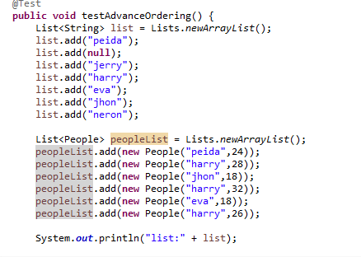
Basic utilities
Ordering

Slide 27
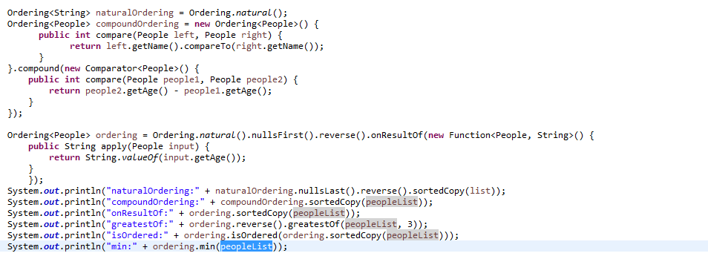
Basic utilities
Ordering

Slide 28
Basic utilities
Throwables： Guava's Throwables utility can frequently simplify dealing with exceptions.
Propagation
Sometimes, when you catch an exception, you want to throw it back up to the next try/catch block. This is frequently the case for RuntimeException or Error instances, which do not require try/catch blocks, but can be caught by try/catch blocks when you don't mean them to.

Slide 29
Basic utilities
Throwables
<X extends Throwable> void throwIfInstanceOf( Throwable throwable, Class<X> declaredType) throws X | throw the exception as-is, if and only if it is an instance of declaredType.
void throwIfUnchecked(Throwable throwable) | Throws if current exception type is Error or RuntimeException.

Slide 30
Basic utilities
Throwables
Causal Chain
Guava makes it somewhat simpler to study the exception chain, providing three useful methods whose signatures are self-explanatory:
Throwable getRootCause(Throwable)
List<Throwable> getCausalChain(Throwable)
String getStackTraceAsString(Throwable)
Notes:
1. getStackTraceAsString’s return value is the same with exception. printStackTrace()

Slide 31
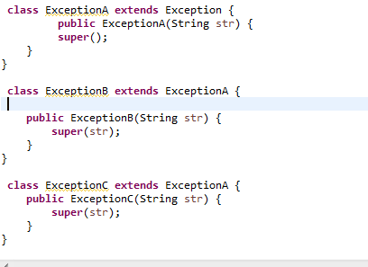
Basic utilities
Throwables

Slide 32
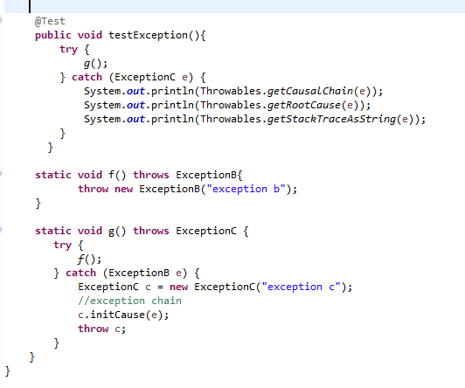
Basic utilities
Throwables

Slide 33
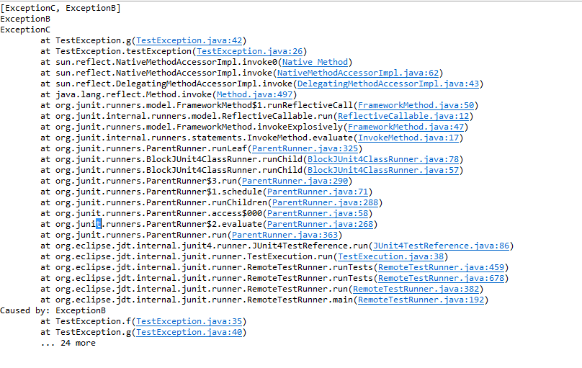
Basic utilities
Throwables

Slide 34
Strings
Joiner
Joining together a sequence of strings with a separator can be unnecessarily tricky -- but it shouldn't be. If your sequence contains nulls, it can be even harder. The fluent style of Joiner makes it simple.
Joiner joiner = Joiner.on("; ").skipNulls();
return joiner.join("Harry", null, "Ron", "Hermione");
returns the string "Harry; Ron; Hermione". Alternately, instead of using skipNulls, you may specify a string to use instead of null with useForNull(String).
You may also use Joiner on objects, which will be converted using their toString() and then joined.
Joiner.on(",").join(Arrays.asList(1, 5, 7)); // returns "1,5,7"
Notes:
1. toString means each element’s toString method.

Slide 35
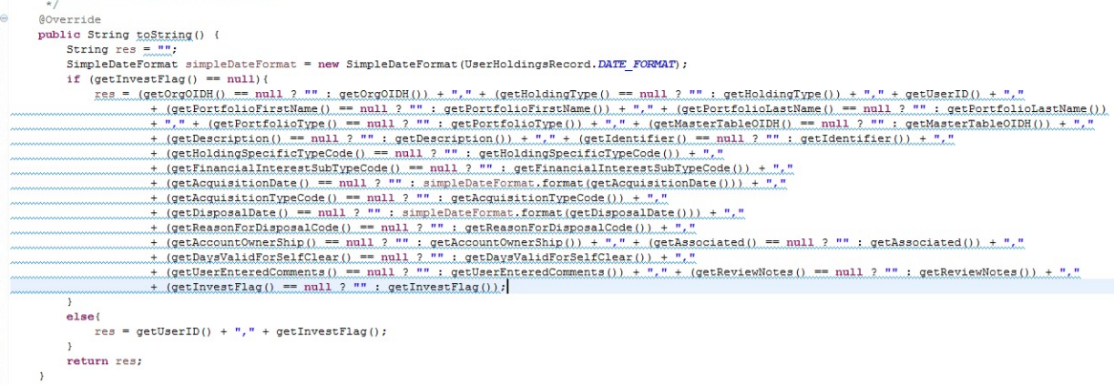
Strings
Joiner

Slide 36
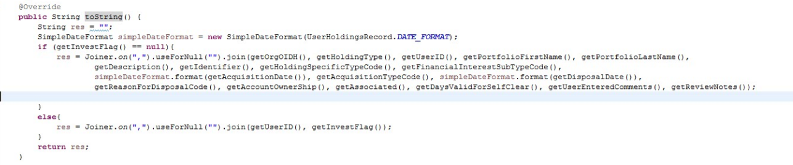
Strings
Joiner

Slide 37
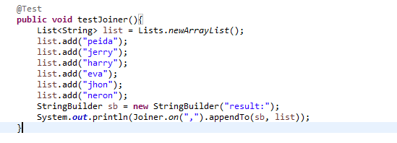
Strings
Joiner
Notes:
Joiner.appendTo method to appent a format string charater.
appendTo method first parameter must implement appendable interface like StringBuilder.

Slide 38
Strings
Splitter
The built in Java utilities for splitting strings can have some quirky behaviors. For example， String.split silently discards trailing separators 。 Quiz：”,a,,b,”.split(“,”) will return？
a.“”, “a”, “”, “b”, “”
b. null, “a”, null, “b”, null
c. “a”, null, “b”
d. “a”, “b”
e. None of the above
Splitter.on(',').trimResults().omitEmptyStrings().split("foo,bar,, qux");
Return value type is Iterable<String>, it’s the all of the collections implemented interface。

Slide 39
Strings
Splitter
Base Factories
Method | Description | Example
Splitter.on(char) | Split on occurrences of a specific, individual character. | Splitter.on(‘;’)
Splitter.on(CharMatcher) | Split on occurrences of any character in some category. | Splitter.on(CharMatcher.BREAKING_WHITESPACE)
Splitter.on(String) | Split on a literal String. | Splitter.on(“, “)
Splitter.on(Pattern) | Split on a regular expression. | Splitter.onPattern(“\r?\n”)
Splitter.fixedLength(int) | Splits strings into substrings of the specified fixed length. The last piece can be smaller than length, but will never be empty. | Splitter.fixedLength(3)

Slide 40
Strings
Splitter
Modifiers
Method | Description
omitEmptyStrings() | Automatically omits empty strings from the result.
trimResults() | Trims whitespace from the results.
trimResults(CharMatcher) | Trims characters matching the specified CharMatcher from results.
limit(int) | Stops splitting after the specified number of strings have been returned.

Slide 41
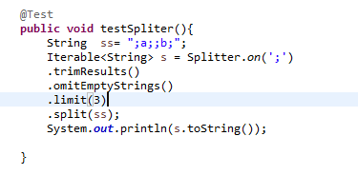
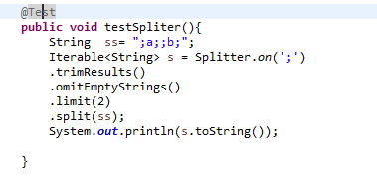
Strings
Splitter
[a, b]
[a, b;]
Notes:
1. Semicolon 分号

Slide 42
Strings
CharMatcher
CharMatcher provides a wide variety of methods to operate on occurrences of the specified characters in any CharSequence： trim、collapse、remove、retain and so on。

Slide 43
Strings
common ways to obtain a CharMatcher include:
Method | Descrition
anyOf(CharSequence) | Specify all the characters you wish matched. For example, CharMatcher.anyOf("aeiou") matches lowercase English vowels.
is(char) | Specify exactly one character to match.
inRange(char, char) | Specify a range of characters to match, e.g. CharMatcher.inRange('a', 'z').
whitespace() | Blank CharMatcher
digit() | Digit CharMatcher
Notes:
CharSequence is the interface of the String and StringBuilder.
isRange method first parameter must less than the second parameter and compared by ASCII value.

Slide 44
Strings
Method | Description
collapseFrom(CharSequence, char) | Replace each group of consecutive matched characters with the specified character. For example, WHITESPACE.collapseFrom(string, ' ') collapses whitespaces down to a single space.
matchesAllOf(CharSequence) | Test if this matcher matches all characters in the sequence. For example, ASCII.matchesAllOf(string) tests if all characters in the string are ASCII.
removeFrom(CharSequence) | Removes matching characters from the sequence.
retainFrom(CharSequence) | Removes all non-matching characters from the sequence.
trimFrom(CharSequence) | Removes leading and trailing matching characters.
replaceFrom(CharSequence, CharSequence) | Replace matching characters with a given sequence.
User CharMatcher
Notes:
1. matchesAllOf method return value is a Boolean value.
2. The replaceFrom method has the same function with collapseFrom method.

Slide 45
Strings
User CharMatcher:
Notes:
Negate取相反的结果
Horizontal line

Slide 46
Collections
ImmutableSet - Immutable Collections
Why?
Immutable objects have many advantages, including:
safe for use by untrusted libraries.
2. Thread-safe: can be used by many threads with no risk of race conditions.
3. Doesn't need to support mutation, and can make time and space savings with that assumption.
4. Can be used as a constant, with the expectation that it will remain fixed.
5. Making immutable copies of objects is a good defensive programming technique. Guava provides simple, easy-to-use immutable versions of each standard Collection type, including Guava's own Collection variations.

Slide 47

Collections
ImmutableSet - Immutable Collections
Making immutable copies of objects

Slide 48
Collections
ImmutableSet - Immutable Collections
The JDK provides Collections.unmodifiableXXX methods, but in our opinion, these can be：
unsafe: the returned collections are only truly immutable if nobody holds a reference to the original collection
inefficient: the data structures still have all the overhead of mutable collections, including concurrent modification checks, extra space in hash tables, etc.
Notes:
1.并发修改的检查比如在遍历一个list的同时对list进行增删就会抛出异常

Slide 49
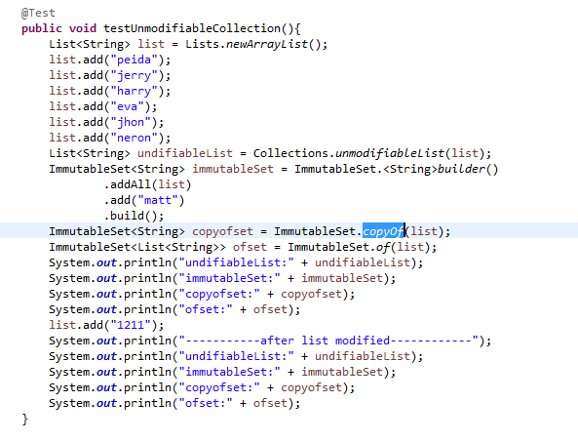
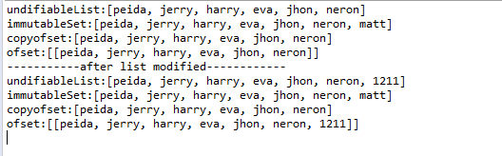
Collections
ImmutableSet - Immutable Collections
Notes:
1.可见通过builder和copyOf可以防止改变原有的集合引用来改变当前不可变集合以达到防御性拷贝的目的。

Slide 50
Collections
ImmutableSet - Immutable Collections
可变集合接口 | 属于JDK还是Guava | 不可变版本
Collection | JDK | ImmutableCollection
List | JDK | ImmutableList
Set | JDK | ImmutableSet
SortedSet/NavigableSet | JDK | ImmutableSortedSet
Map | JDK | ImmutableMap
SortedMap | JDK | ImmutableSortedMap
Multiset | Guava | ImmutableMultiset
SortedMultiset | Guava | ImmutableSortedMultiset
Multimap | Guava | ImmutableMultimap
ListMultimap | Guava | ImmutableListMultimap
SetMultimap | Guava | ImmutableSetMultimap
BiMap | Guava | ImmutableBiMap
ClassToInstanceMap | Guava | ImmutableClassToInstanceMap
Table | Guava | ImmutableTable
Notes:
NavigableSet对SortedSet进行了拓展，添加了一些方法， 典型的实现类是TreeSet，我们经常用它对set进行排序
SortedMap是对Map进行的拓展，支持对map的排序
Mutiset下面会讲到
Multimap可以允许我们一个key mapping到多个value上
ListMutimap和SetMutimap是Multimap的两种实现类，ListMutiMap的value是一个list，而SetMutimap的value是一个Set
BiMap可以实现双向映射，通过调用inverse方法实现key value的反转，但是得确保value是唯一的，要不然会抛出IllegalArgumentException
ClassToInstanceMap是一种特殊的Map：它的键是类型，而值是符合键所指类型的对象。
Table 毋庸置疑是一个table， 它可以调用put方法保存行，列和value.

Slide 51
Collections
Multiset
There are two main ways of looking at this:
1. This is like an ArrayList<E> without an ordering constraint: ordering does not matter.
2. This is like a Map<E, Integer>, with elements and counts.
When treated as a normal Collection, Multiset behaves much like an unordered ArrayList：
1. Calling add(E) adds a single occurrence of the given element.
2. The iterator() of a Multiset iterates over every occurrence of every element.
3. The size() of a Multiset is the total number of all occurrences of all elements.
The additional query operations, as well as the performance characteristics, are like what you’d expect from a Map<E, Integer>：
count(Object) returns the count associated with that element.
entrySet() returns a Set<Multiset.Entry<E>> which works analogously to the entrySet of a Map.
3. elementSet() returns a Set<E> of the distinct elements of the multiset.
4. The memory consumption of Multiset implementations is linear in the number of distinct elements.。

Slide 52
Collections
Method | Description
count(E) | Count the number of occurrences of an element that have been added to this multiset.
elementSet() | View the distinct elements of a Multiset<E> as a Set<E>.
entrySet() | Similar to Map.entrySet(), returns a Set<Multiset.Entry<E>>, containing entries supporting getElement() and getCount().
add(E, int) | Adds the specified number of occurrences of the specified element.
remove(E, int) | Removes the specified number of occurrences of the specified element.
setCount(E, int) | Sets the occurrence count of the specified element to the specified nonnegative value.
size() | Returns the total number of occurrences of all elements in the Multiset.
Multiset
Notes:
elementSet方法返回的是key的set
add方法和setCount方法的作用是一样的，都可以重设当前计数

Slide 53
Collections
Implementations
Map | Corresponding Multiset | Supports null elements
HashMap | HashMultiset | Yes
TreeMap | TreeMultiset | Yes
LinkedHashMap | LinkedHashMultiset | Yes
ConcurrentHashMap | ConcurrentHashMultiset | No
ImmutableMap | ImmutableMultiset | No
Guava provides many implementations of Multiset, which roughly correspond to JDK map implementations.

Slide 54
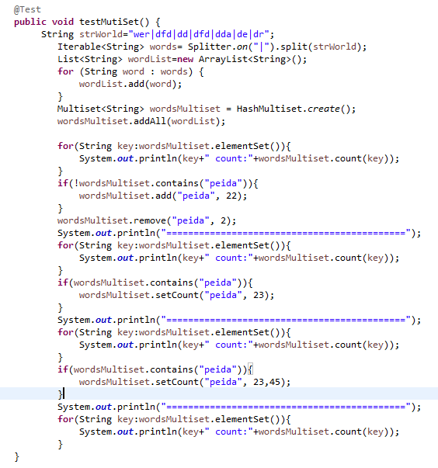
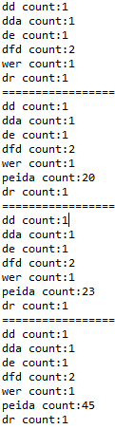
Collections
Implementations
Notes:
1. setCount(“peida”, 23, 45)其中第二个参数是old count, 第三个参数是new count, 如果old count与实际count相等，new count会被set，如果不相等就不会set

Slide 55
Collections
RangeSet
A RangeSet describes a set of disconnected, nonempty ranges. When adding a range to a mutable RangeSet, any connected ranges are merged together, and empty ranges are ignored. For example:
RangeSet<Integer> rangeSet = TreeRangeSet.create();
rangeSet.add(Range.closed(1, 10)); // {[1,10]}
rangeSet.add(Range.closedOpen(11, 15));// disconnected range :{[1,10], [11,15)}
rangeSet.add(Range.closedOpen(15, 20)); // connected range; {[1,10], [11,20)}
rangeSet.add(Range.openClosed(0, 0)); // empty range; {[1,10], [11,20)}
rangeSet.remove(Range.open(5, 10)); // splits [1, 10]; {[1,5], [10,10], [11,20)}
Notes:
1. 带open的函数代表小括号，closed代表中括号

Slide 56
Collections
Views
complement()： views the complement of the RangeSet.
subRangeSet(Range<C>)： returns a view of the intersection of the RangeSet with the specified Range
asRanges()： views the RangeSet as a Set<Range<C>> which can be iterated over.

Slide 57
Collections
Queries
In addition to operations on its views, RangeSet supports several query operations directly, the most prominent of which are:
contains(C)： the most fundamental operation on a RangeSet, querying if any range in the RangeSet contains the specified element.
rangeContaining(C)： returns the Range which encloses the specified element, or null if there is none.
encloses(Range<C>)： straightforwardly enough, tests if any Range in the RangeSet encloses the specified range. 。
span()： returns the minimal Range that encloses every range in this RangeSet.
Notes:
Contains返回的是一个布尔值。
rangeContaining返回的是一个range对象是一个区间
Encloses判断当前对象是否有区间包含在给定的Range中

Slide 58
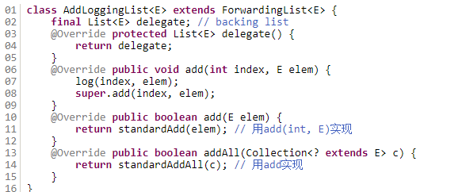
Collections
Forwarding Decorators
The Forwarding classes define one abstract method, delegate(), which you should override to return the decorated object. Each of the other methods delegate directly to the delegate: so, for example, ForwardingList.get(int) is simply implemented as delegate().get(int).
Notes:
装饰器需要重写delegate方法

Slide 59
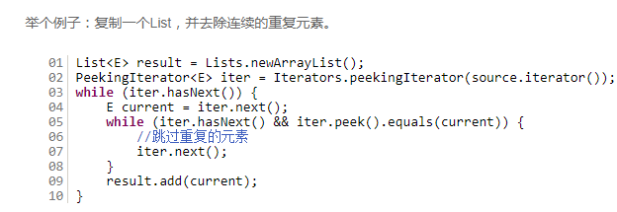
Collections
PeekingIterator
Iterators supports the method Iterators.peekingIterator(Iterator), which wraps an Iterator and returns a PeekingIterator, a subtype of Iterator that lets you peek() at the element that will be returned by the next call to next().
Notes:
1.在调用peek之前也需要调用hasNext方法校验下一个元素是否存在，如果不存在调用peek函数的话会抛出NoSuchElementException。

Slide 60
Thanks!

